Slide 1


Memorable Liver Biopsy
Romil Saxena, MBBS, MD, FRCPath (UK) Emory University
AIPNA @CAP2023
Breakfast Meeting Monday Oct 9th

Slide 2




50 year old female Cholecystectomy
Found to have splenomegaly
Imaged enlarged liver, spleen 27 cm
Hepatology ?cirrhosis liver biopsy

Slide 3
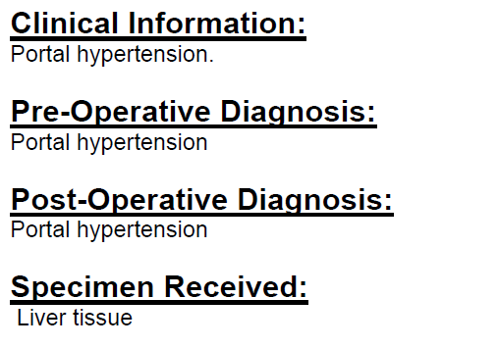

Slide 4
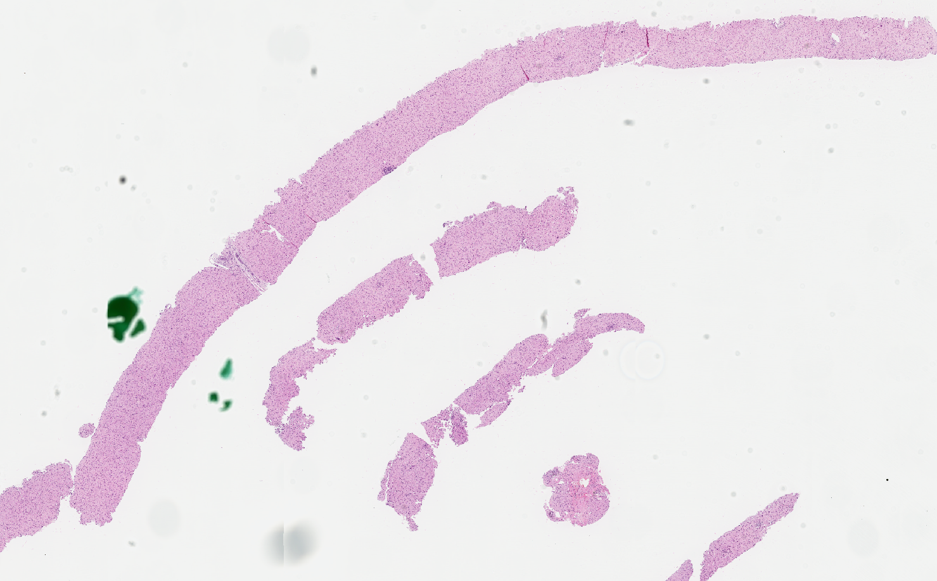

Slide 5
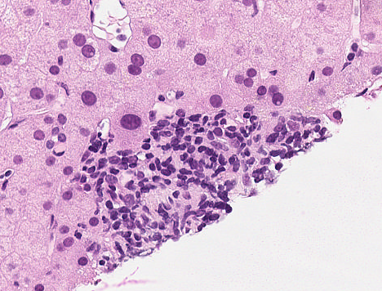
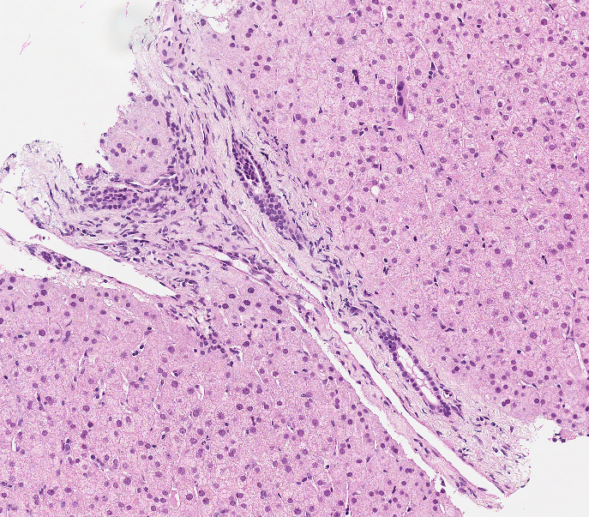
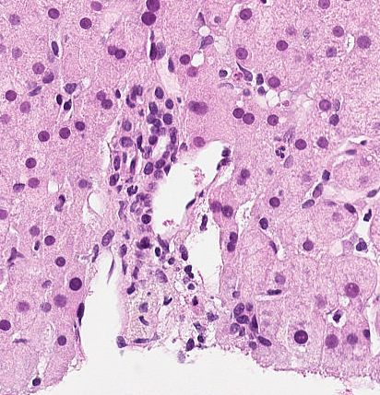

Slide 6
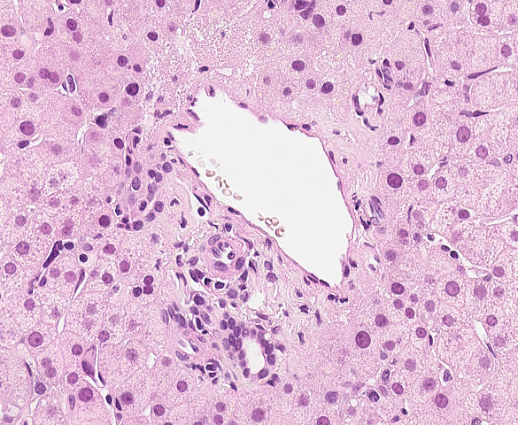
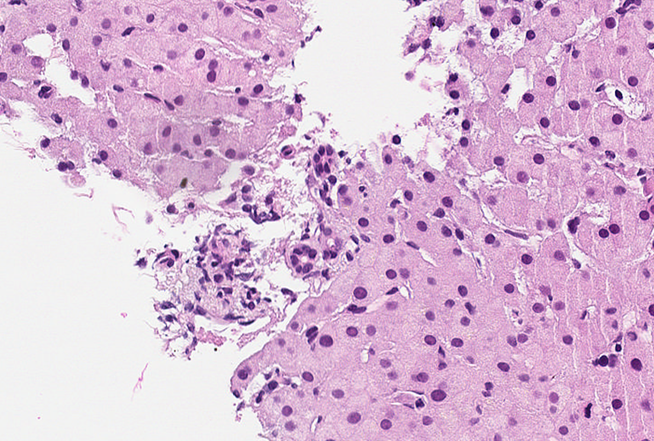
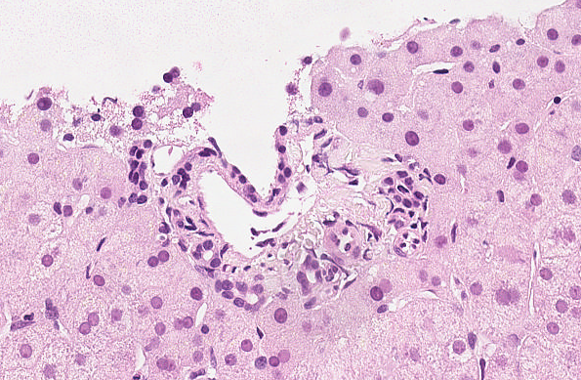

Slide 7
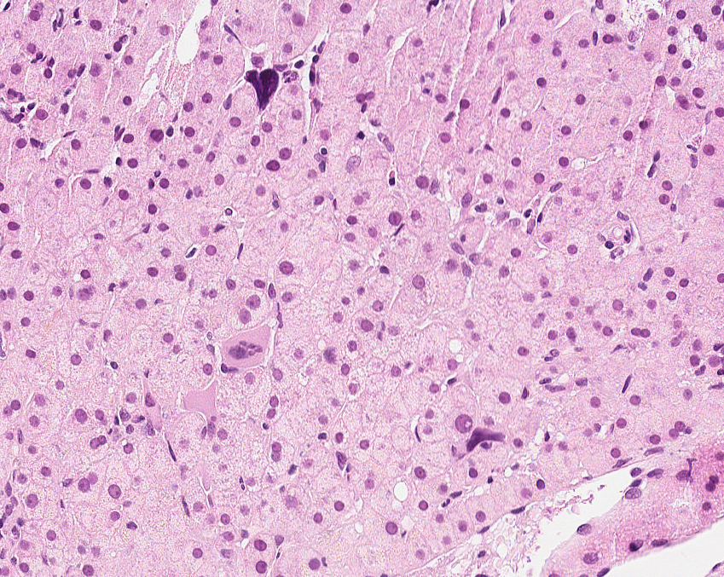
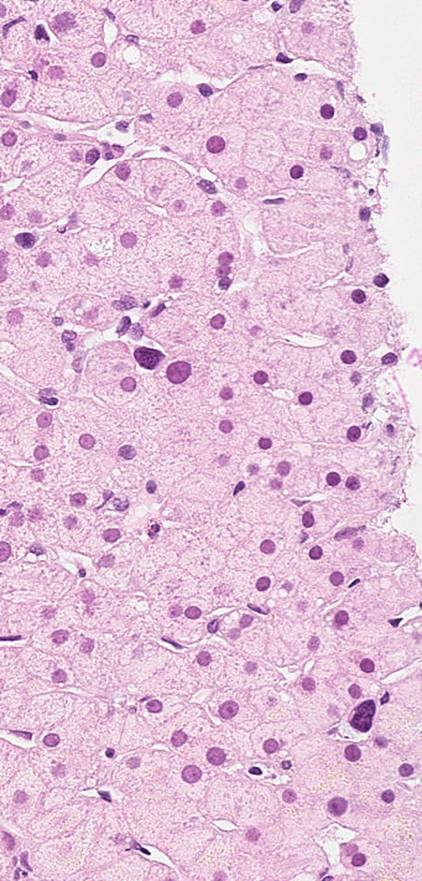

Slide 8
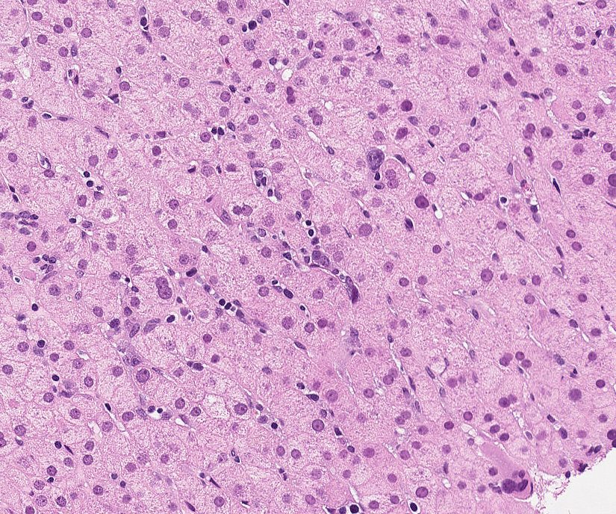

Slide 9
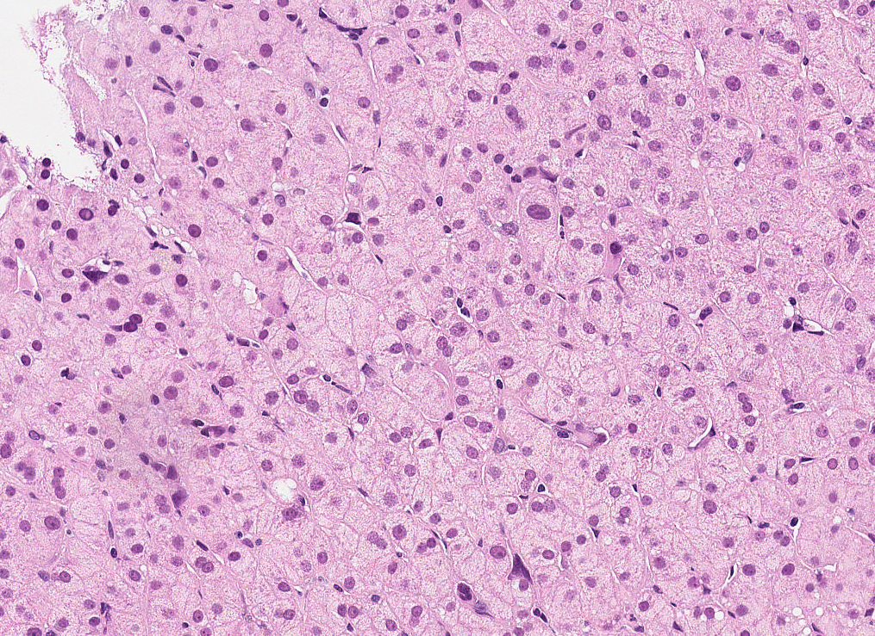

Slide 10
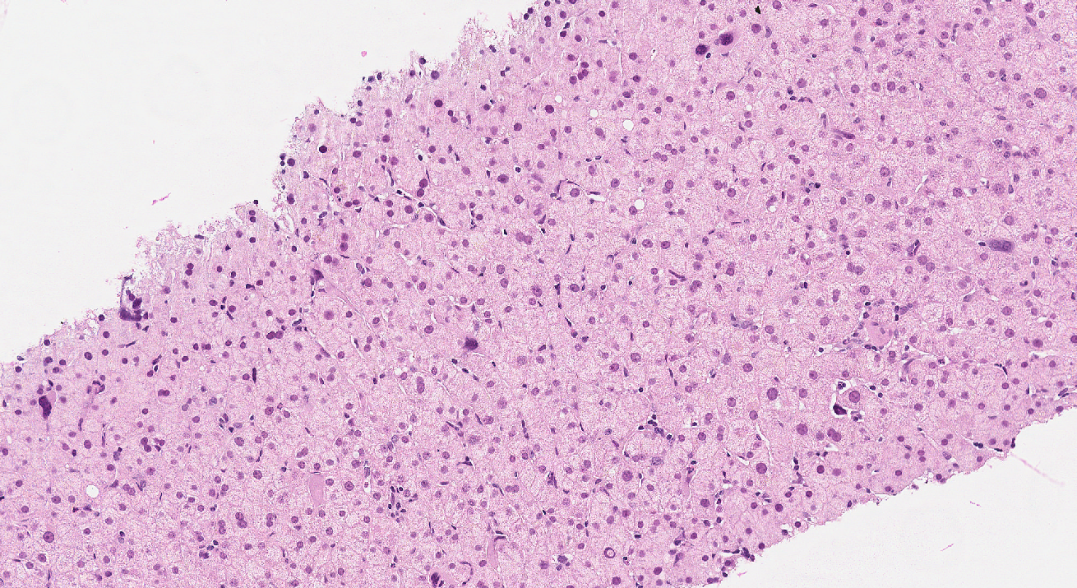

Slide 11
Diagnosis
No cirrhosis, NRH
Numerous megakaryocytes and atypical cells
Suggestive of a myeloproliferative disorder, or BM replacement by an infiltrative process

Slide 12
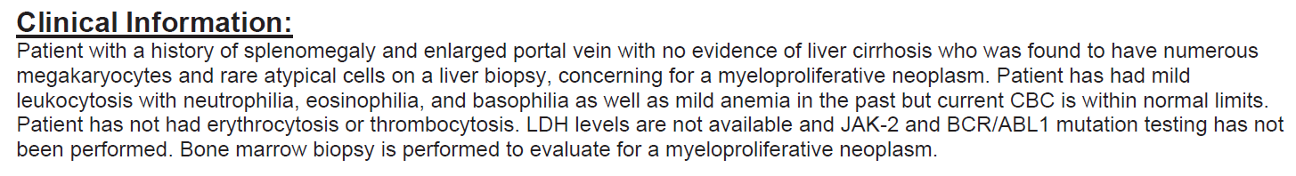
Bone marrow biopsy

Slide 13
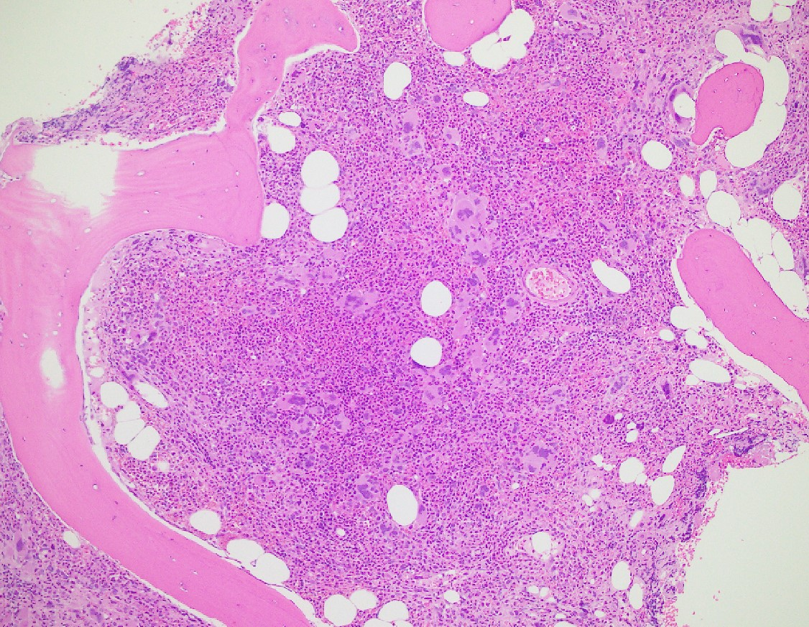

Slide 14
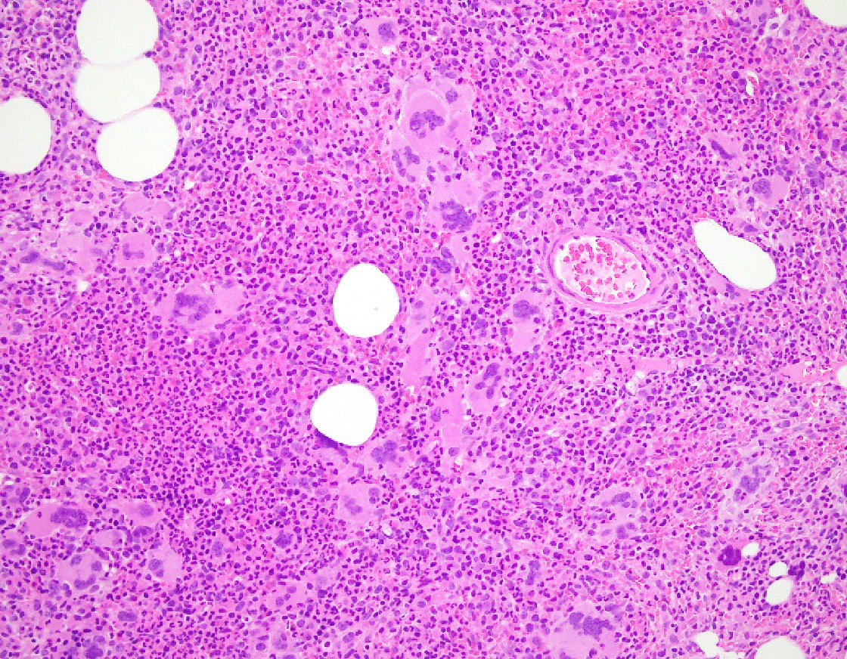

Slide 15
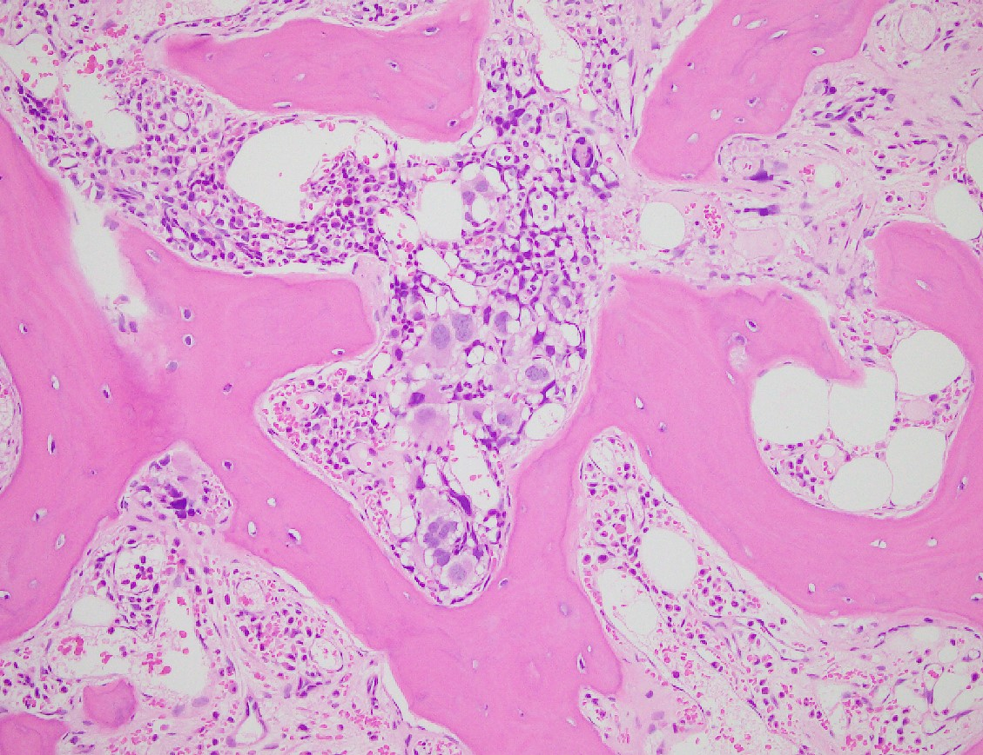

Slide 16
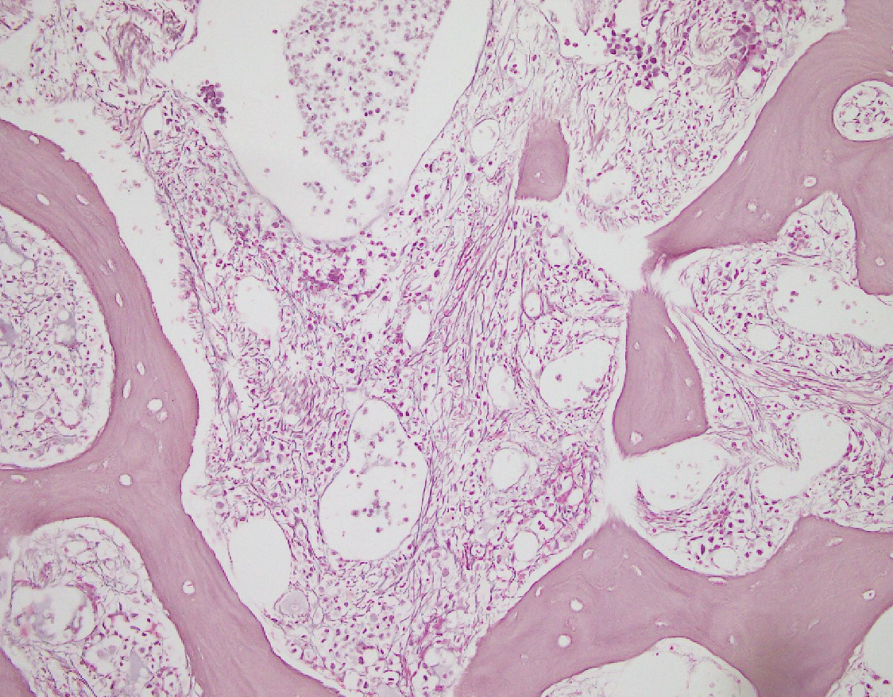

Slide 17
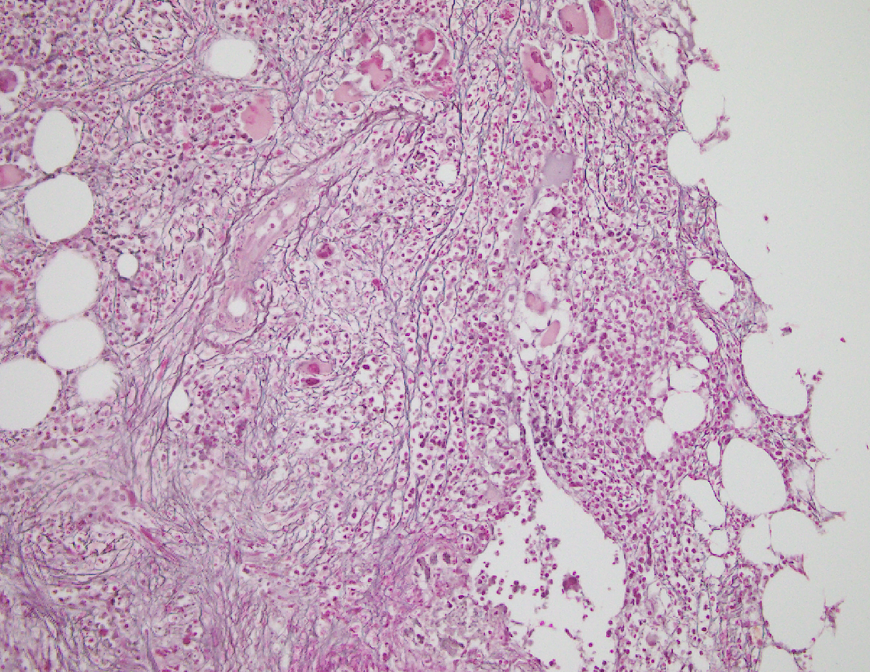

Slide 18
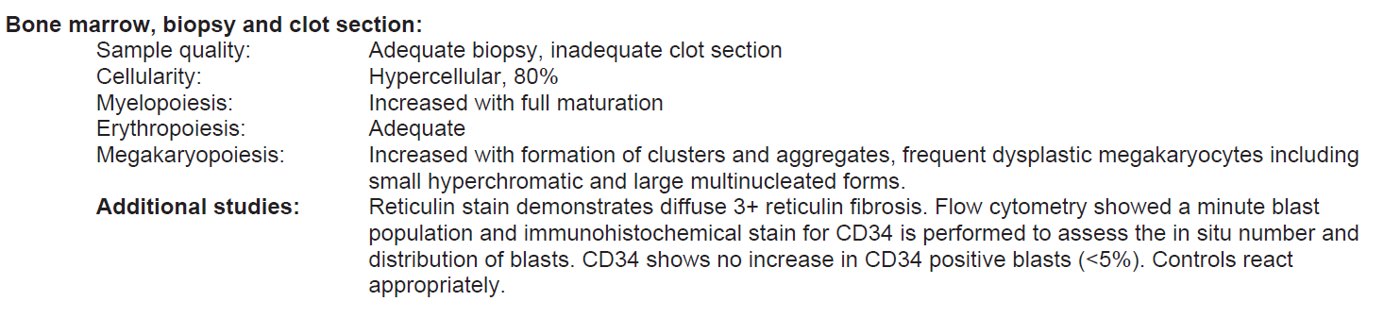
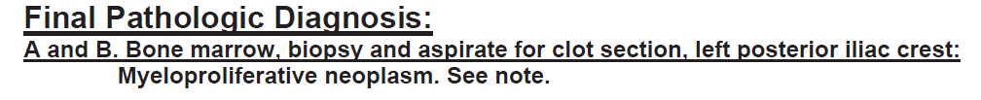
Negative for BCR/ABL1 fusion (not CML)
JAK2 mutation +
BM report: Shanxiang Zhang, MD (Indiana University)

Slide 19
A year later

Slide 20
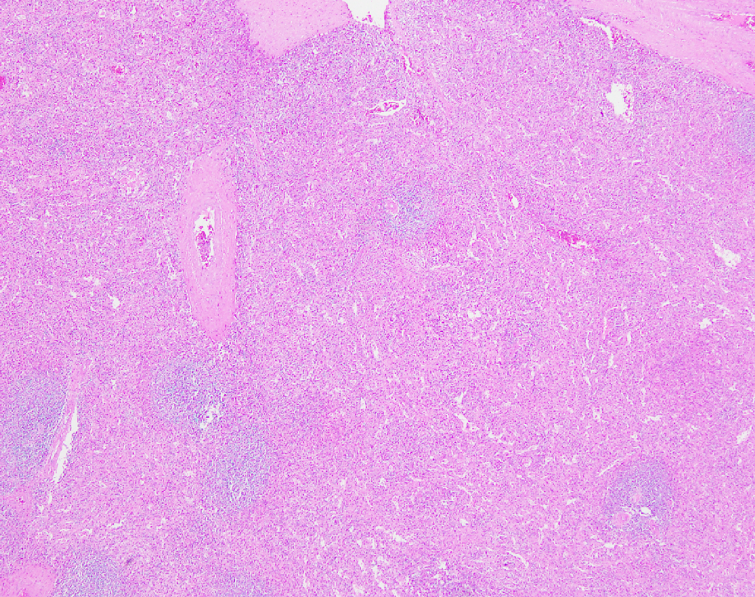

Slide 21

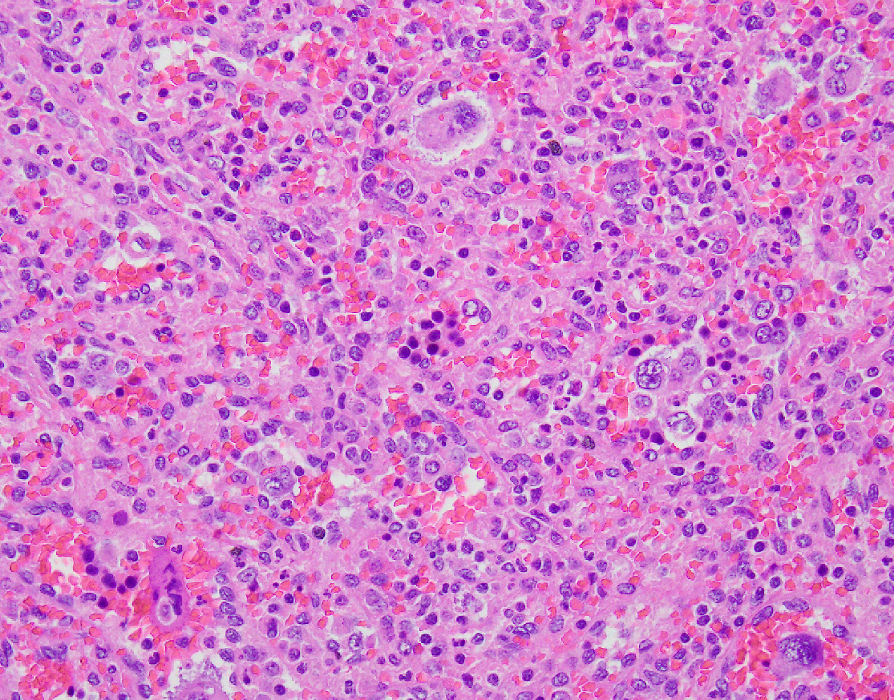

Slide 22
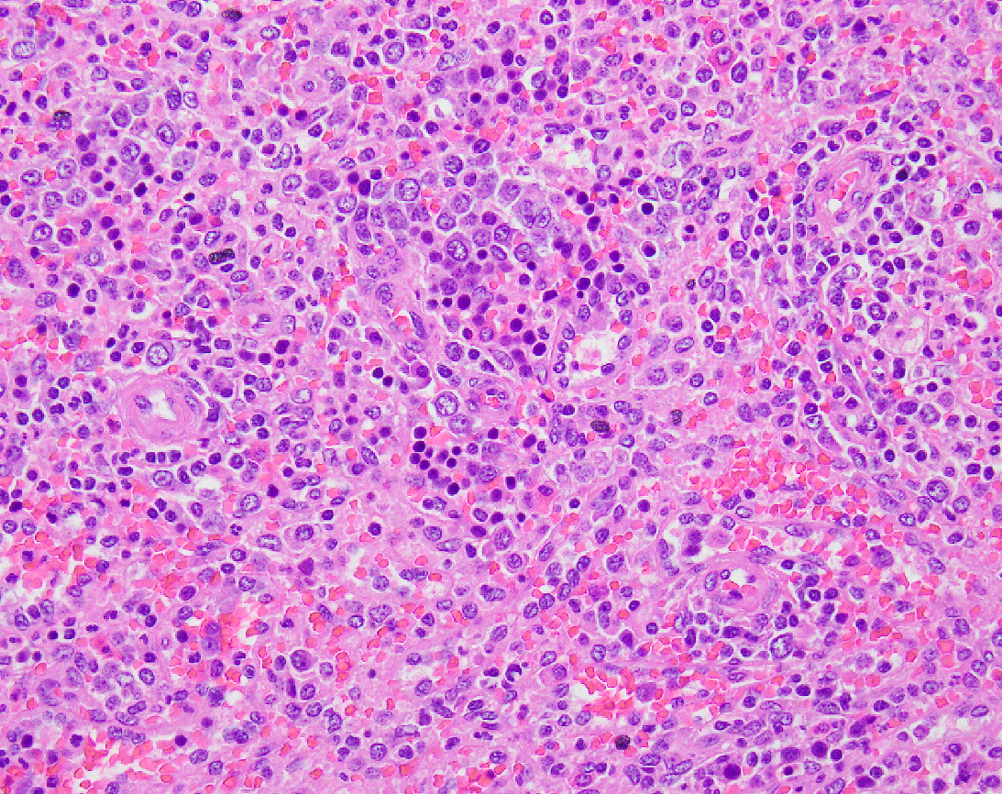

Slide 23
Follow up
Started on hydroxyurea stopped taking
5 years later, 2% blasts
Offered BMT declined
Alive at last follow up (late 2022)

Slide 24
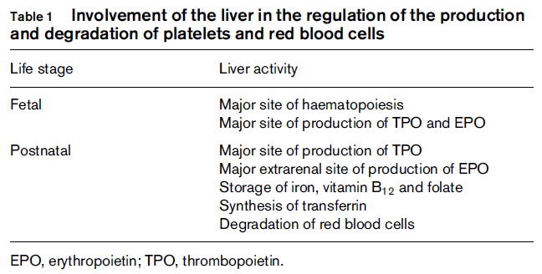
Hematopoeisis in Liver
Jelkmann et al. European Journal of Gastroenterology & Hepatology 2001, 13:791-801

Slide 25
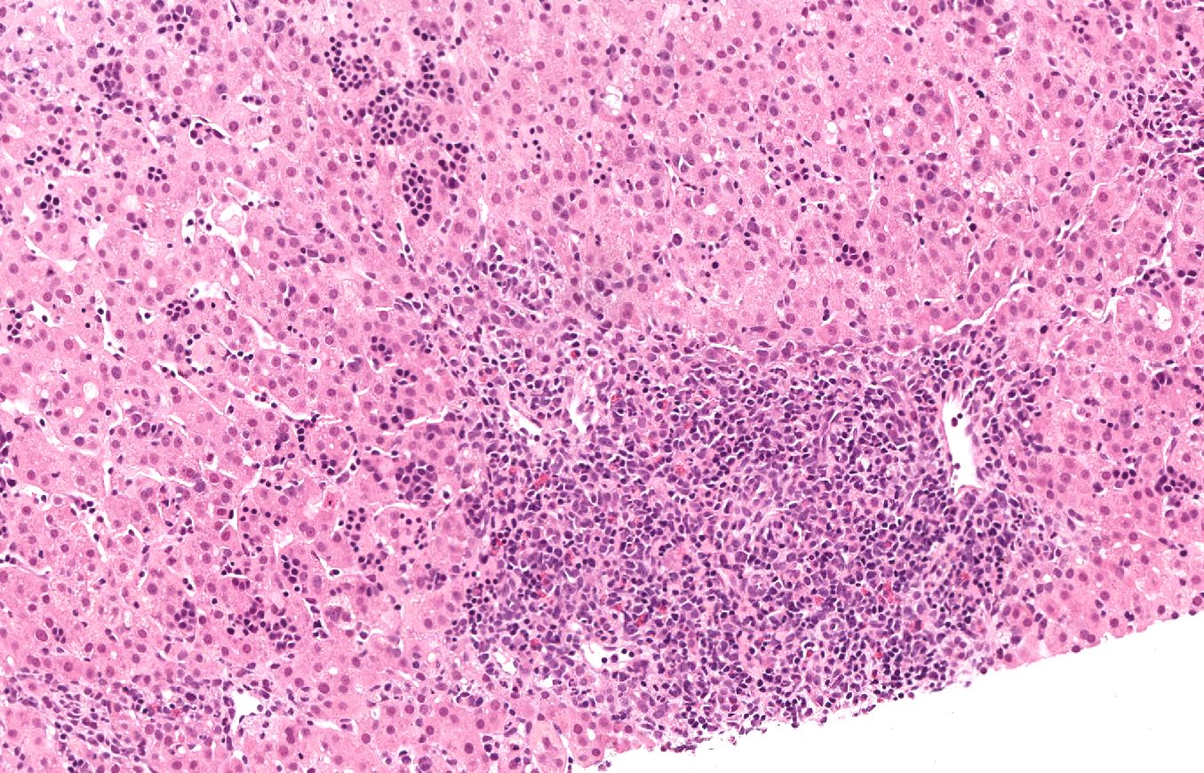

Slide 26
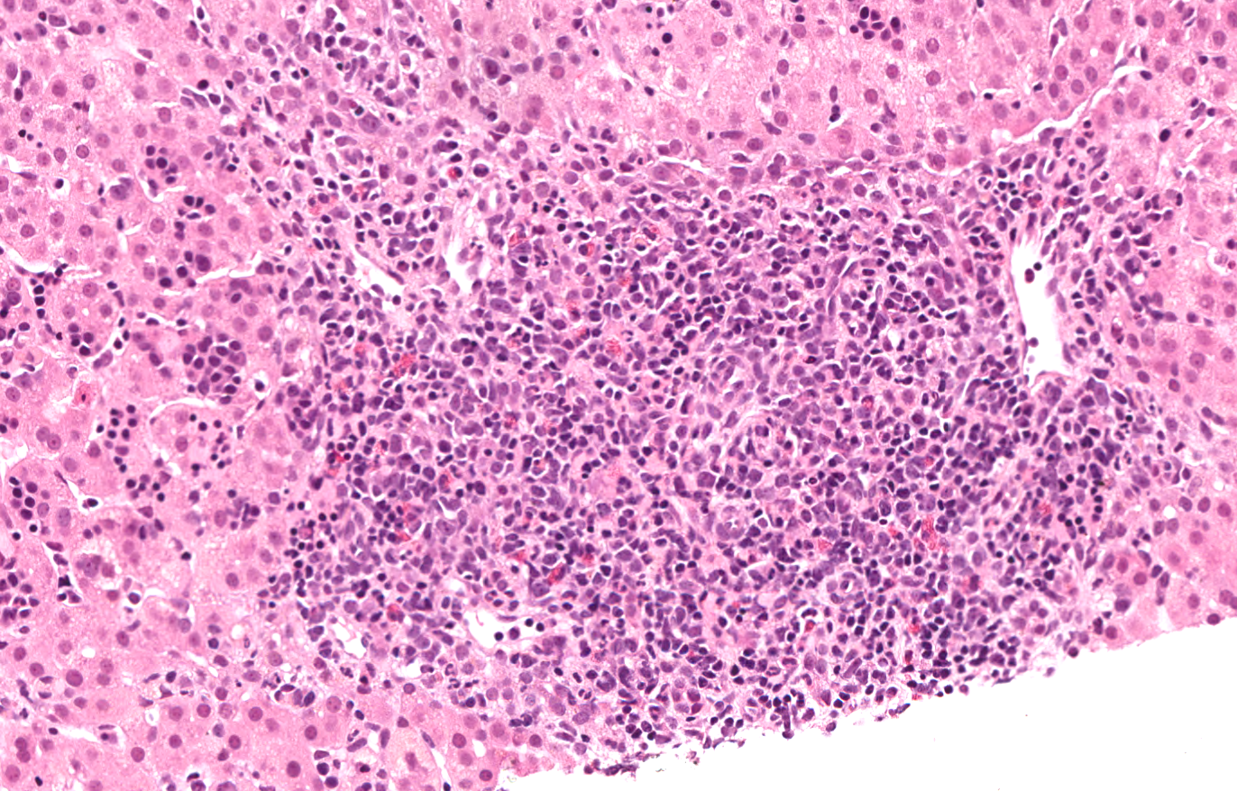

Slide 27
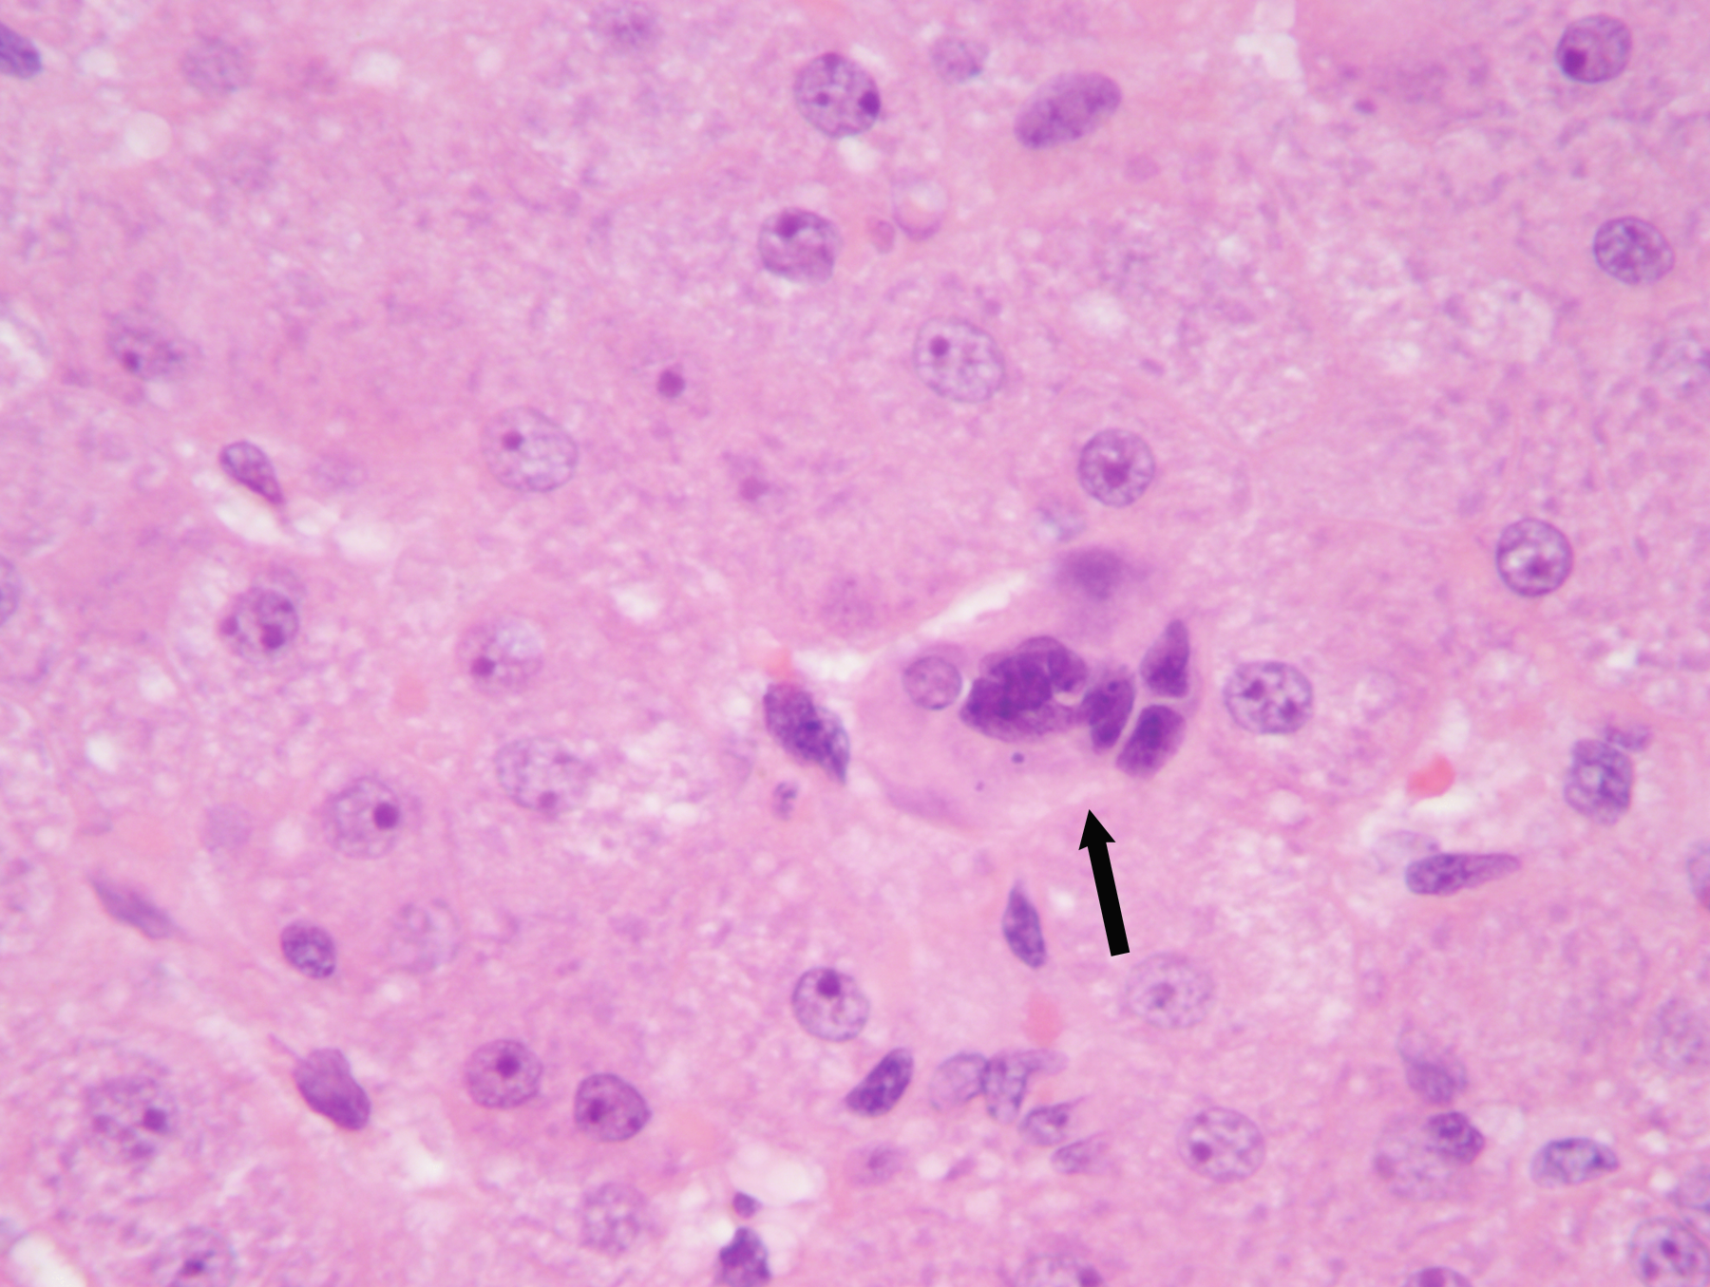
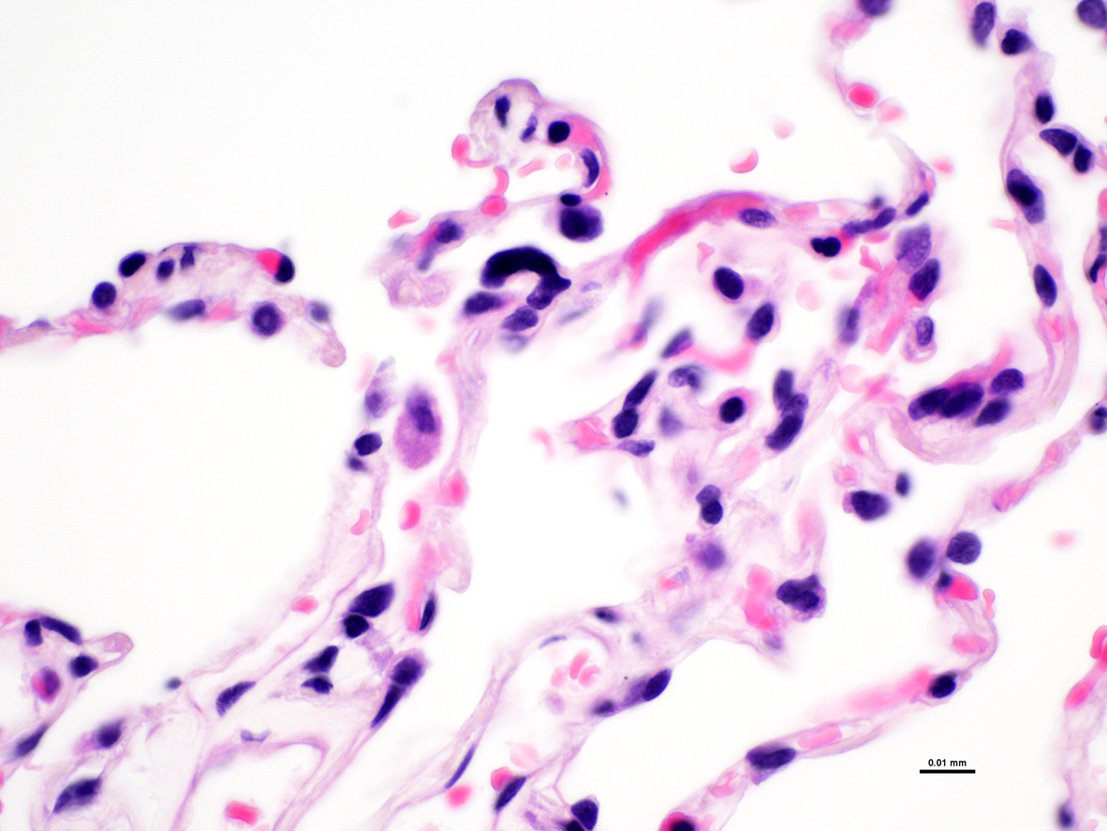

Courtesy: Frank Schneider, MD @Emory

Slide 28
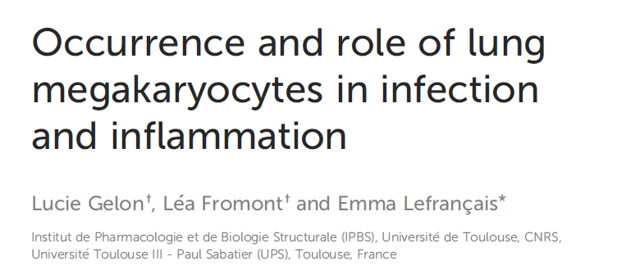
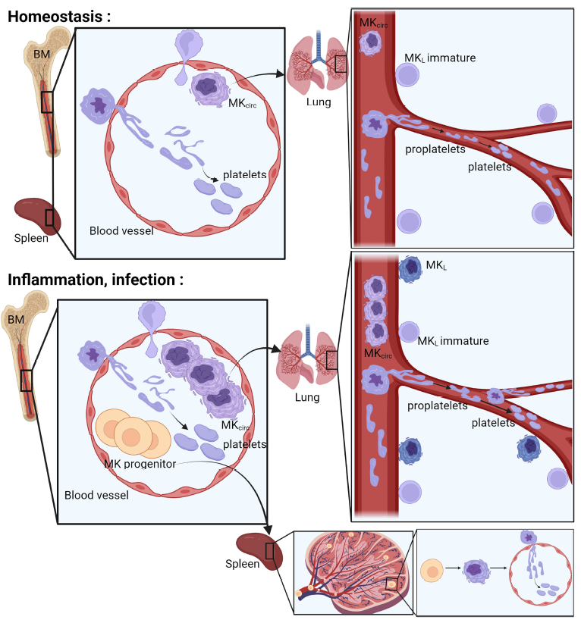

Slide 29
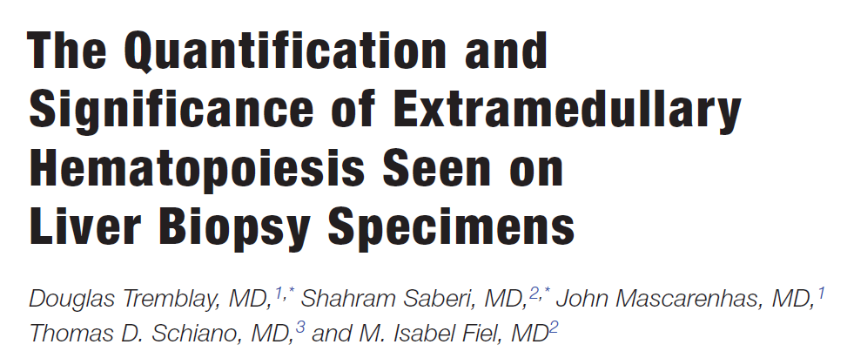

Slide 30
42 patients; median 50 years; 44% female
Abnormal LFTs (64%), intraop bx (24%), abnormal imaging (10%)
~half had splenomegaly
40% hematologic disorder:
MF, PV, lymphoma, sickle, ITP
60% had non-hematologic
Cirrhosis (viral, AIH, ALD, PSC), IBD, solid tumors, CHF

Slide 31
Score | 10 random HPFs (40x)
0 | No foci
1 | ≤ 2
2 | 3 -5
3 | ≥ 6

Slide 32
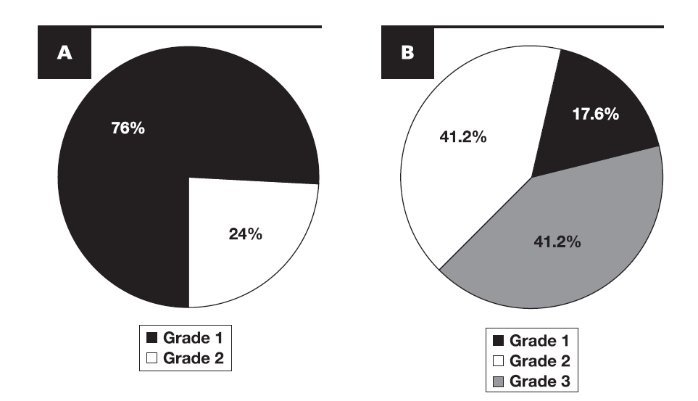
A: non-hematologic; B – hematologic
Am J Clin Pathol 2022;158:277-282

Slide 33
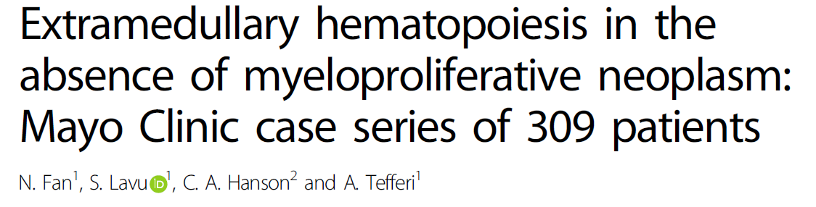
Blood Cancer Journal (2018) 8:119

Slide 34
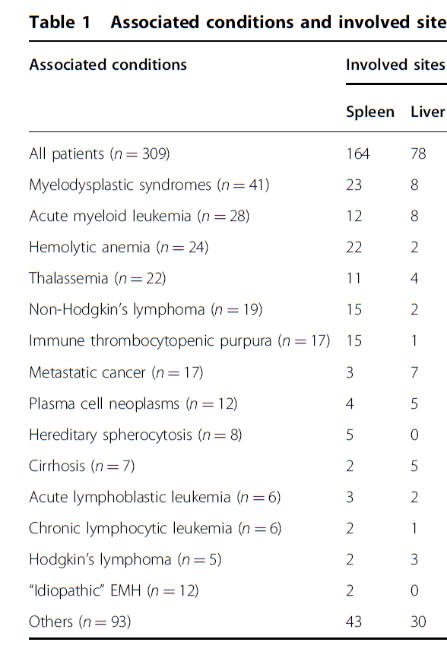

Slide 35
Primary Myelofibrosis
Least common of MP neoplasms
Equal gender predisposition
Disease of older adults (~60 years)
Evolves from an early pre-fibrotic stage to late fibrotic stage
Prefibrotic stage accounts for 30-50% of all cases
Increasing incidence due to early diagnosis

Slide 36
Pathophysiology
Clonal stem cell defect: abnormal megas, granulocytes in BM
PDGF, BFGF, TGFβ
Non-neoplastic fibroblasts deposit collagen
Extramedullary hematopoeisis (liver, spleen)
Tear drop red blood cells
Angiogenesis in BM, spleen - ↑ serum VEGF

Slide 37
Molecular profile
Karyotypic abnormalities 50% of cases
Driver mutations
JAK2 V617F (50-60% of cases)
CALR mutations (25-30%): better survival
MPL mutations (5-10%)
Triple negative: shortest survival
No BCR-ABL fusion (CML)

Slide 38
Clinical Features
Asymptomatic 30%; symptomatic 70%
Fatigue, weight loss, low grade fever etc.
Anemia
Leukocytosis, thrombocytosis, thrombosis, hemorrhagic episodes
Splenomegaly (90%) – hallmark
Hepatomegaly (50%); PH may precede onset of disease

Slide 39
Diagnostic Criteria
Major and minor criteria for prefibrotic/ overt fibrotic stages

Slide 40
Diagnostic criterion
Major criteria
Major criterion 1: megakaryocytic proliferation and atypia, accompanied by reticulin or collagen fibrosis grades 2 or 3
Major criterion 2: not meeting WHO criteria for other myeloproliferative neoplasms or myelodysplastic syndromes
Major criterion 3: demonstration of JAK2, CALR or MPL mutation OR other clonal marker OR no evidence of reactive marrow fibrosis
Minor
Minor criterion 1: anemia not attributed to a comorbid condition
Minor criterion 2: leukocytosis
Minor criterion 3: palpable splenomegaly
Minor criterion 4: increased serum lactate dehydrogenase
Minor criterion 5: leukoerythroblastosis

Slide 41
Prognosis
DIPSS: Dynamic International Prognostic Scoring System
8 predictors of poor survival
Risk status defined by # of adverse prognostic factors
0-4 (low, intermediate 1, intermediate 2, high)

Slide 42
Prognosis
Least favorable of all MP neoplasms
Leukemic transformation, thrombotic/hemorrhagic complications, infections
Survival
Pre-fibrotic: 10-15 years
Overt fibrotic: 3 to 5 years

Slide 43

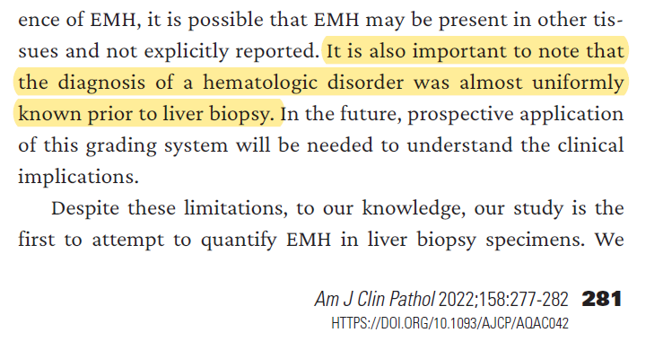

Slide 44
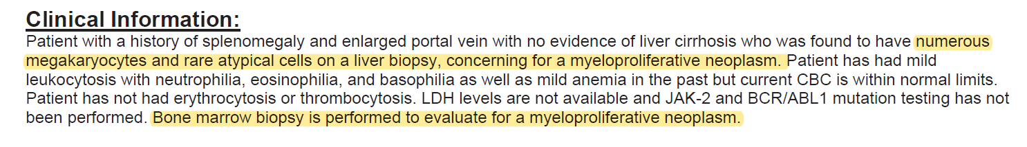

Slide 45
References
Fan N et al. Extramedullary hematopoiesis in the absence of myeloproliferative neoplasm: Mayo Clinic case series of 309 patients. Blood Cancer Journal. 2018; 8:119
Tremblay D et al. The Quantification and Significance of Extramedullary Hematopoiesis Seen on Liver Biopsy Specimens. Am J Clin Pathol. 2022;158:277-282
Jelkmann W. The role of the liver in the production of thrombopoietin compared with erythropoietin. Eur J Gastroenterol Hepatol 2001; 13:791 – 801.
Kaseb H, Hudnall SD. Primary myelofibrosis. PathologyOutlines.com website. https://www.pathologyoutlines.com/topic/myeloproliferativemyelofibrosis.html. Accessed March 2nd, 2023.

Slide 46

Thank You

